Slide 1
MGMT 58600: Python Programming
Lecture 1
Dr. Shoaib Khan

Slide 2
What is Programming?
Programming refers to the process of telling a computer which tasks to perform in order to solve a problem.
You can think of programming as a collaboration between humans and computers.
Humans write a set of instructions (the program) for a computer to follow in a language computers can understand.

Slide 3
What is Python?
Python is an open-source, object-oriented, high-level, general purpose programming language.
Open-source: it's free and source code is available for further improvements, like adding helpful features or fixing bugs
Object-oriented: based not on functions but on data abstractions called classes/objects with defined attributes and methods
High-level: human-friendly rather than computer-friendly
General purpose: can be used to create any kind of programs

Slide 4
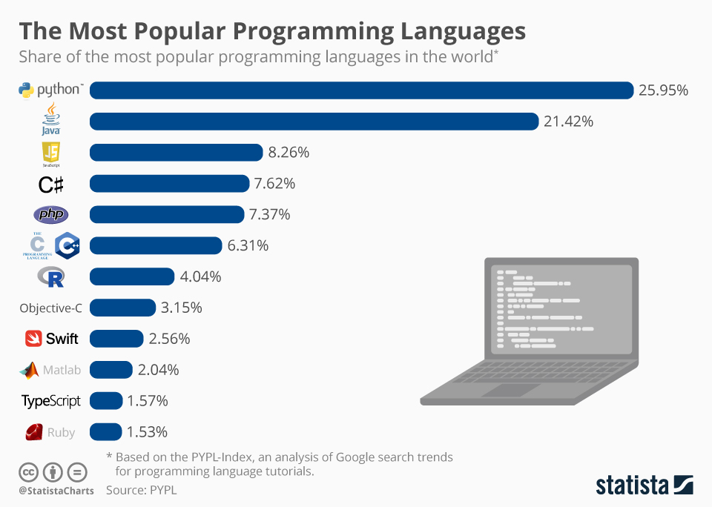
Why Python?

Slide 5
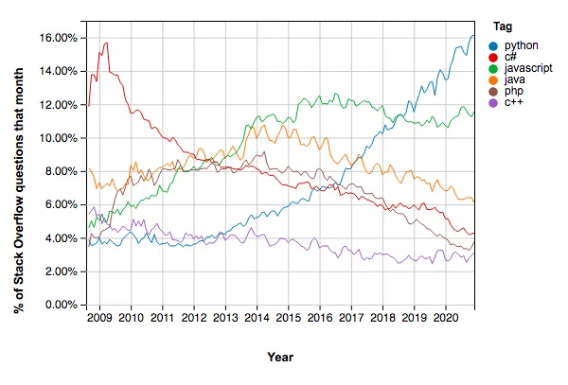
Demand for Python Programming
Python is on a major growth trajectory.

Slide 6
Why is Python so Popular?
It's free both for individuals and businesses
It has an intuitive syntax that resembles natural English language and hence is easy to learn
Because of its human-friendly syntax, it's easy to write, read, and debug
It provides an extensive standard library and a wide choice of well-documented and comprehensive additional libraries and modules
Python is a cross-platform programming language that allows code to run on different operating systems with minimal changes
Thanks to its huge supporting community, Python is constantly developed, improved, and expanded
It can be integrated into any project and used for solving advanced problems
Being a general-purpose language, it has various applications in many industries

Slide 7
What is Python Used For?
1. Python for Data Analysis
Data has become a truly precious asset in any modern industry
Companies are interested in gathering, manipulating, and analyzing relevant data to extract meaningful business insights from it
This is where Python goes beyond any competition with libraries like Pandas and Numpy
2. Python for Data Visualization
Data visualization is an essential part of data analysis that helps us represent information in a more compelling and insightful form
Python offers a wide spectrum of tools for visualizing the data. The most popular of them are Matplotlib and Seaborn

Slide 8
What is Python Used For?
3. Python for Machine Learning
Machine learning (ML) is at the core of the majority of data science tasks
It is a field of artificial intelligence (AI) that uses algorithms to enable machines to learn patterns and trends from historical data and make predictions on new data.
Using ML techniques, we can create models that can, for instance:
accurately predict the customer churn rate of the company
estimate the risk of a person having a certain disease
identify the optimal positioning of taxi vehicles, etc.
Python offers powerful ML libraries like scikit-learn, Keras, TensorFlow, and PyTorch.

Slide 9
What is Python Used For?
4. Python for Software Development
Besides its numerous application in data science areas, Python is used at each stage of software development, including:
build control
automated continuous compilation
prototyping, bug tracking, testing, and software maintenance.
5. Python for Web Development
While for building the front end of a website (the part of a website accessible to its users), we would mostly use the languages such as HTML, CSS, and JavaScript, for its back end (the business logic part of a website), we would often opt for Python.
Among the giant websites and applications created using Python, it's worth mentioning Google, Facebook, Instagram, YouTube, Dropbox, and Reddit.

Slide 10
What is Python Used For?
6. Python for Task Automation/Scripting
Python is a great tool for writing programs to automate different repetitive tasks. This process is also called scripting.
You can do scripting to work with files and folders, e.g., create, rename, or delete files, check them for errors, duplicates, or find certain text patterns, or update the file content.
You can also use Python automation to search and download information from the internet
Complete and submit online forms
Send regular notifications or emails, etc.

Slide 11
What is Python Used For?
7. Miscellaneous Python Uses
Monitoring the stock market
Web scraping
Keeping updated a to-do list
Generating random data.
Creating bots, etc.

Slide 12
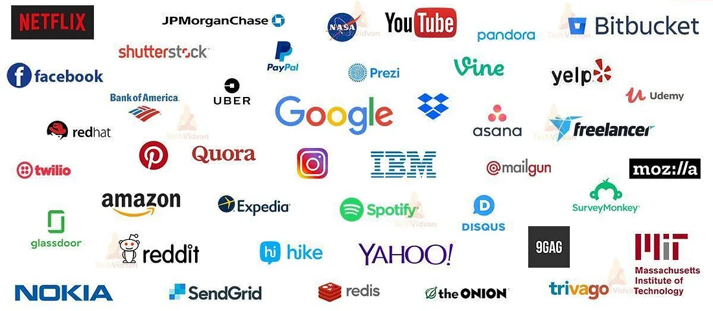
Top Companies/Institutions That Use Python

Slide 13
Getting Python
To install python on your machine, visit https://www.python.org/downloads/
Download the latest version and follow the default installation process.
This process will also install IDLE, the interactive Python IDE(Integrated Development Environment).
Let’s explore it a bit (Run IDLE before proceeding to next slide).

Slide 14
Python Basics
Entering Expressions:
Enter 2 + 2 at the prompt to have Python do some simple math.
2 + 2 is called an expression, which is the most basic kind of programming instruction in the language.
Expressions consist of values (such as 2) and operators (such as +), and they can always evaluate (that is, reduce) down to a single value.

Slide 15
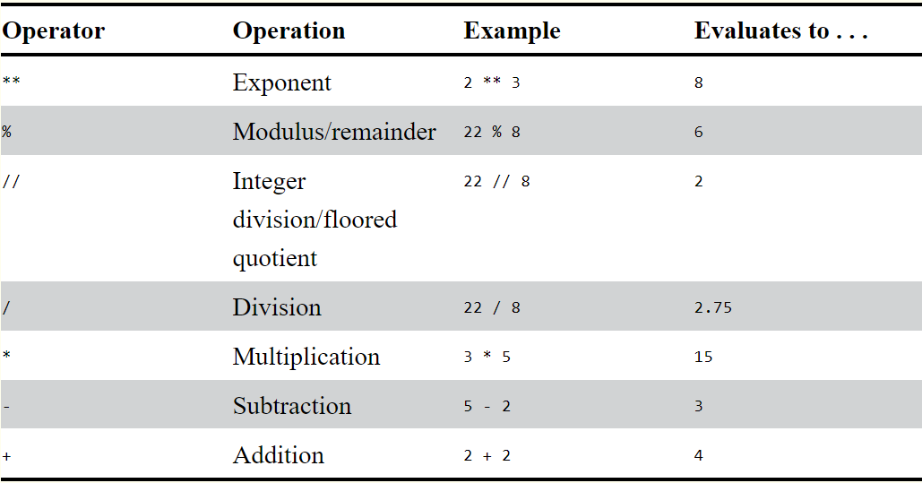
Python Basics
List of Math Operators:
The order of operations (also called precedence) of Python math operators is similar to that of mathematics (PEMDAS evaluated from left to right).

Slide 16
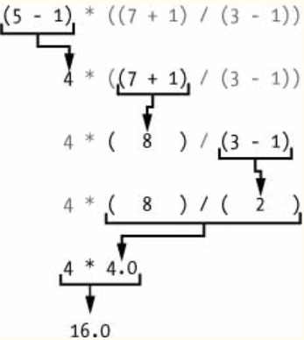
Precedence of Operators
Evaluating: >>> (5 - 1) * ((7 + 1) / (3 - 1))
16.0

Slide 17
Syntax
The rules for putting operators and values together to form expressions are a fundamental part of Python as a programming language, just like the grammar rules that help us communicate. Here’s an example:
This is a grammatically correct English sentence.
This grammatically is sentence not English correct a.
The second line is difficult to parse because it doesn’t follow the rules of English. Similarly, if you enter a bad Python instruction, Python won’t be able to understand it and will display a SyntaxError error message, as shown here:
>>> 5 + File "<stdin>", line 1 5 + ^ SyntaxError: invalid syntax >>> 42 + 5 + * 2 File "<stdin>", line 1 42 + 5 + * 2 ^ SyntaxError: invalid syntax

Slide 18
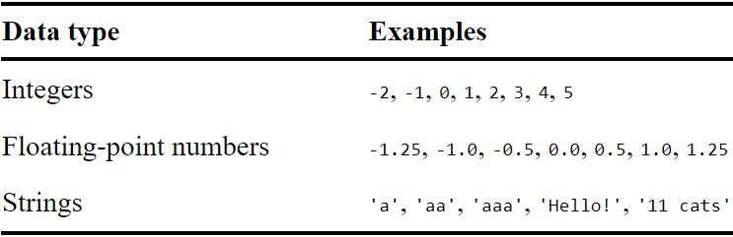
Basic Datatypes
A data type is a category for values, and every value belongs to exactly one data type.
The most common data types in Python are (int, float, str):

Slide 19
String Concatenation & Replication
The meaning of an operator may change based on the data types of the values next to it.
When + is used on two string values, it joins the strings as the string concatenation operator.
>>> 'Alice' + 'Bob' 'AliceBob’
When the * operator is used on one string value and one integer value, it becomes the string replication operator.
>>> 'Alice' * 5 'AliceAliceAliceAliceAlice'

Slide 20
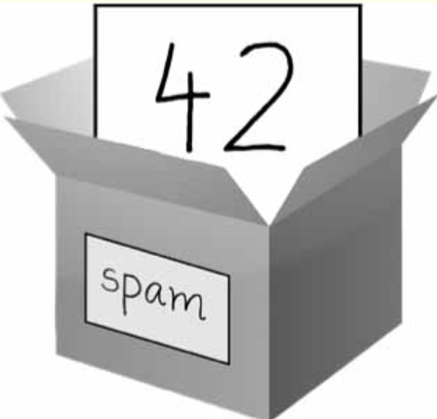
Variables and Assignment
A variable is like a box in the computer’s memory where you can store a single value.
If you want to use the result of an evaluated expression later in your program, you can save it inside a variable.
You’ll store values in variables with an assignment statement
An assignment statement consists of a variable name, an equal sign (called the assignment operator), and the value to be stored.
If you enter the assignment statement spam = 42, then a variable named spam will have the integer value 42 stored in it.

Slide 21
➊ >>> spam = 40 >>> spam 40 >>> eggs = 2 ➋ >>> spam + eggs 42 >>> spam + eggs + spam 82 ➌ >>> spam = spam + 2 >>> spam 42
>>> spam = 'Hello' >>> spam 'Hello' >>> spam = 'Goodbye' >>> spam 'Goodbye'

